Slide 1
Lecture 8
Logistic Regression
Faculty of Computer Science
Data Analysis
Moscow 2025
Lecturer: Alisa Melikyan, amelikyan@hse.ru, PhD,
Associate Professor of the School of Software Engineering

Slide 2
Logistic Regression
Data Analysis
Lecture 8
Logistic Regression
Type of regression model | Dependent Variable | Predictors
Binary | Binary (yes, no) | Interval or ratio scale variables Binary variables Categorical variables (series of dummy variables)
Multinomial | More than two values (Computer Science, Mathematics, Business, Sociology)
Ordinal | More than two values which are ordered (acceptable, good, excellent)

Slide 3
Multinomial regression
Data Analysis
Lecture 8
Logistic Regression
Multinomial logistic regression is used to model nominal outcome variables. The analysis breaks the outcome variable down into a series of comparisons between two categories.
If we have three outcome categories (A, B and C), then the analysis will consist of two comparisons. The form that these comparisons take depends on how we have selected a baseline category. The important parts of the analysis and output are much the same as binary logistic regression.
We will calculate the probability that the case belongs to each of the groups, that are formed based on the values of the dependent variable. We will predict that according to the model a case belongs to the group with maximum probability.

Slide 4
Multinomial logistic regression
Data Analysis
Lecture 8
Logistic Regression
Dependent Variable: recommended specialization for a student
Values of the Dependent Variable:
Software Engineering,
Data Science,
Business Analytics,
Computer Science (baseline category),
Applied Mathematics.
We will test 4 binary models:
Software Engineering vs. Computer Science
Data Science vs. Computer Science
Business Analytics vs. Computer Science
Applied Mathematics vs. Computer Science

Slide 5
Preliminary Data Analysis
Data Analysis
Lecture 8
Logistic Regression
Frequency and contingency tables could help to reveal the completeness of information representation in the dataset and identify some trends and relationships.

Slide 6
Interpreting Results
Data Analysis
Lecture 8
Logistic Regression
Gender : 1 – male, 0 – female (reference group)
Dependent variable has 3 values: Breakfast bar, Oatmeal, Cereal (baseline category).
Question: How the gender influences the breakfast choice?
(-,147) – males compared to females are less likely to go for Breakfast bar rather than Cereal.
(,053) – males compared to females are more likely to go for Oatmeal rather than Cereal.
Positive B coefficient indicates that as the predictor increases the chance to be in the current category increases.

Slide 7
Results Interpretation
Data Analysis
Lecture 8
Logistic Regression
OR
OR = ODDSm/ODDSf = 0,864 т.е. odds for males is about 14% lower than odds for females to get Breakfast Bar instead of Cereal.
OR = ODDSm/ODDSf = 1,05 т.е. odds for males is about 5% greater than odds for females to get Breakfast Bar instead of Cereal.

Slide 8
Results Interpretation
Data Analysis
Lecture 8
Logistic Regression
Coef (B) | RRR=exp(b) | Interpretation
> 0 | > 1 | Males compared to females (reference group) are more likely to be in the current group than in the reference group. Exp(b)=1,6 -> odds for males is 60% higher than odds for females
= 0 | = 1 | Males and females are equally likely to be in the current and the reference groups.
< 0 | from 0 to 1 | Males compared to females (reference group) are less likely to be in the current group than in the reference group. Exp(b)=0,6 -> Odds for males is 40% lower than odds for females

Slide 9
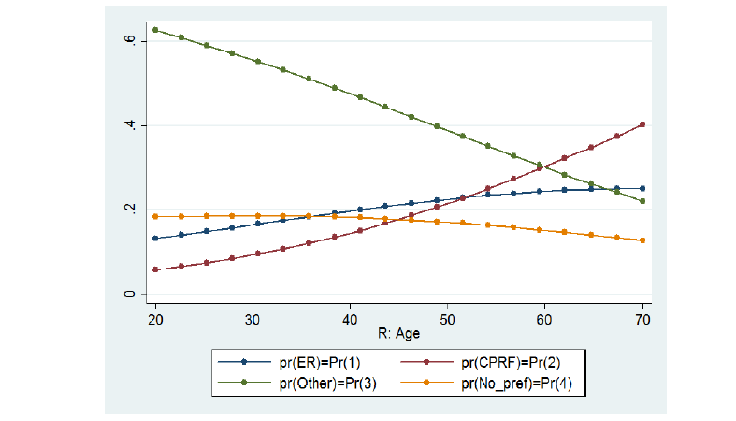
Graphical representation
Data Analysis
Lecture 8
Logistic Regression

Slide 10
Ordinal regression
Data Analysis
Lecture 8
Logistic Regression
Ordinal regression is used to model ordinal outcome variables. We can rank the values of the ordinal variable, but the real distance between categories is unknown.
Instead of considering the probability of an individual event, we consider the probability of that event and all events that are ordered before it.

Slide 11
Dependent Variable
Data Analysis
Lecture 8
Logistic Regression
The ordinal dependent variable ‘Level of Education’ has the following values:
      1 – no education
      2 – secondary education
      3 – higher education
      4 – PhD
As a result of analysis, we will calculate the probability to achieve particular educational level and all the levels, which are below it.

Slide 12
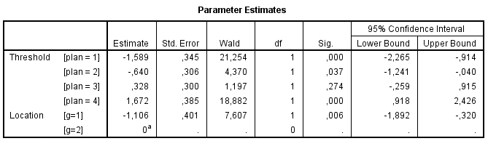
Interpreting the results
Data Analysis
Lecture 8
Logistic Regression
Predictor is gender: 1 – male, 2 – female (reference group). As the coefficient is negative (-1,106), males are less likely to get higher results than females.

Slide 13
Testing Parallel Lines
Data Analysis
Lecture 8
Logistic Regression
When you fit an ordinal regression, you assume that the relationships between the independent variables and the logits are the same for all the logits. That means that the results are a set of parallel lines or planes – one for each category of the outcome variable. You can check this assumption by allowing the coefficients to vary, estimating them, and then testing whether they are all equal.

Slide 14
Useful links
Data Analysis
Lecture 8
Logistic Regression
Multinomial Regression:
http://www.int-arch-photogramm-remote-sens-spatial-inf-sci.net/XL-8/193/2014/isprsarchives-XL-8-193-2014.pdf
https://www.datasklr.com/logistic-regression/multinomial-logistic-regression
Ordinal Regression:
www.norusis.com/pdf/ASPC_v13.pdf
https://www.statsmodels.org/devel/examples/notebooks/generated/ordinal_regression.html?highlight=ordinal
https://www.stata.com/meeting/germany08/GSUG2008.pdf

Slide 15
Thank you for your attention!
Faculty of Computer Science
Data Analysis
Moscow 2025

